Slide 1

COMP1516
Lesson 9: Regular Expressions

Slide 2
Topics
Regular expressions
re object and its methods
re metacharacters
re special sequences
re sets and lists
re examples
split()

Slide 3
Regular Expressions
Regular expressions are very commonly used throughout computer programming.
Regular expressions are strings. In particular, our regex will be simpler if we use raw strings r””:
stackoverflow.com/questions/12871066/what-exactly-is-a-raw-string-regex-and-how-can-you-use-it
Regular expressions are used for pattern matching in other strings.
Patterns can be created, found, replaced, and much more.
Examples:
Consider a string; does it match the pattern of an email address, or a postal code, or a phone number?

Slide 4
re Object and Its Methods
To use regular expressions in python, we must import re
The re object has methods such as match, search, split, findall, finditer and sub.
The order for parameters in python is generally needle, haystack.
Example:
import re
string = “this is british columbia”
matches = re.findall(r“i[ts]”, string) # the re object is what we will use
print(matches) # a list is returned of all four matches of “i followed by t or s”: [‘is’, ‘is’, ‘it’, ‘is]
https://docs.python.org/3/library/re.html

Slide 5
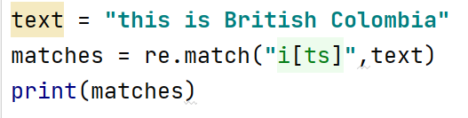

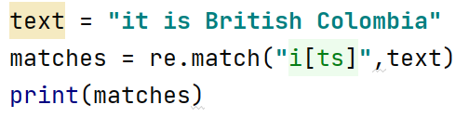

re Object and Its Methods: re.match()
match() and search() return None if no match can be found. If they’re successful, a match object instance is returned, containing information about the match: where it starts and ends, the substring it matched, and more.
Method match() searches and returns the first occurrence of the given pattern.
If a match was found at the beginning of the string, it returns the first occurrence
If no match was found it returns None
Example: Output:

Slide 6
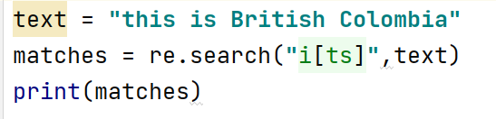
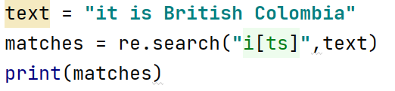
re Object and Its Methods: re.search()
Method search() will search the whole string for the regular expression pattern and returns the first occurrence however, unlike match() it will check all the characters of the string
A match object is returned if a match is found; None is returned if no match was found
Example: Output

Slide 7
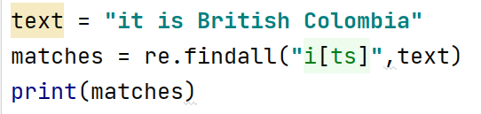

re Object and Its Methods: re.findall()
Method findall() searches the string and returns a list of “all” the occurrences that match the given pattern
If a match was found, it returns a list of all the matches
If no match was found, it returns None
Example Output:

Slide 8
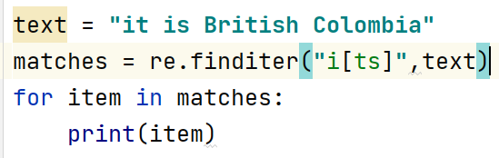
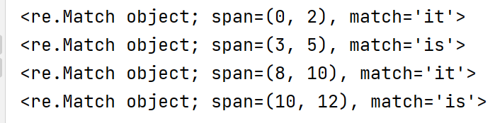
re Object and Its Methods: re.finditer()
Method finditer() returns an iterator yielding a match object of all the occurrences of the given pattern in the string
Example: Output:

Slide 9
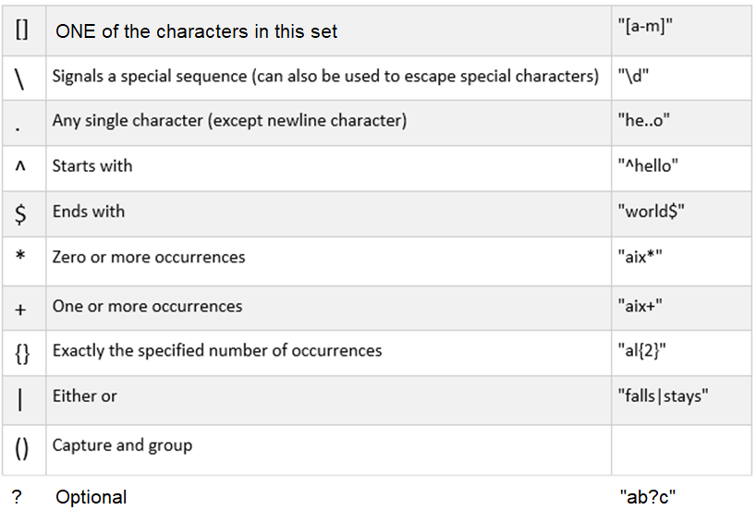
re metacharacters

Slide 10
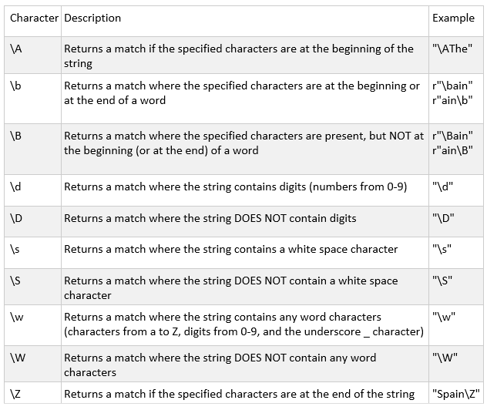
re Special Sequences

Slide 11
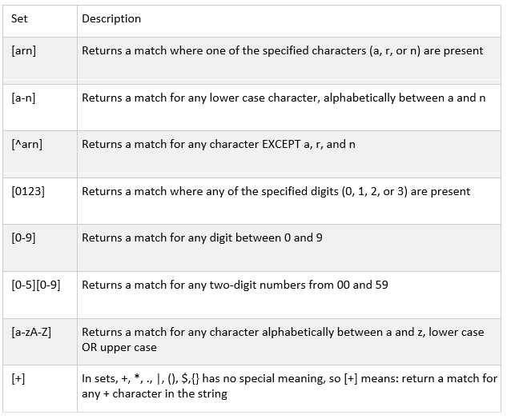
re Sets and Lists
The [square brackets] indicate lists, ranges, and/or lists of ranges
- means “range between” unless – is the first or last character in the []
[] indicates one character
^ means “not” if ^ is the first character in the []
Most characters are literal in [] (such as *, +, etc) except for [] and – and ^ and \

Slide 12
re Examples
abcdefg contains a
aeiou contains a
AEIOU does not contain a
a1b2c3d4 contains a
a12b34c56 contains a
jason_harrison@bcit.ca contains a
bcit does not contain a
2012-02-29 does not contain a
BCIT SFU UBC MIT does not contain a
a@b.com contains a
$123.45 does not contain a
$67.78.33 does not contain a
1999-12-25 does not contain a
$111.222 does not contain a
x@d..com does not contain a
5'11" does not contain a
2020-01-31 does not contain a
6'12" does not contain a
-5'9" does not contain a
grrrrrrrrrrrrrrrr does not contain a
aaaeeeeeeeiiiiiii contains a
aaaeeeeeeeiiiiiii! contains a
jason,harrison,bcit,45 contains a
tiger,woods,golfer,100 does not contain a
shaquille,o'neal,basketball,101 contains a
i = 0
while i < len(strings):
string = strings[i]
if re.search(r"a", string):
print("%s contains a" % string)
else:
print("%s does not contain a" % string)
i += 1
import re
strings = ("abcdefg", "aeiou", “AEIOU”,
"a1b2c3d4",
"a12b34c56",
"jason_harrison@bcit.ca",
"bcit",
"2012-02-29",
"BCIT SFU UBC MIT",
"a@b.com",
"$123.45",
"$67.78.33",
"1999-12-25",
"$111.222",
"x@d..com",
"5'11\"",
"2020-01-31",
"6'12\"",
"-5'9\"",
"grrrrrrrrrrrrrrrr",
"aaaeeeeeeeiiiiiii",
"aaaeeeeeeeiiiiiii!",
"jason,harrison,bcit,45",
"tiger,woods,golfer,100",
"shaquille,o'neal,basketball,101"
)

Slide 13
re Examples: Case Insensitivity
abcdefg contains a
aeiou contains a
AEIOU contains a
a1b2c3d4 contains a
a12b34c56 contains a
jason_harrison@bcit.ca contains a
bcit does not contain a
2012-02-29 does not contain a
BCIT SFU UBC MIT does not contain a
a@b.com contains a
$123.45 does not contain a
$67.78.33 does not contain a
1999-12-25 does not contain a
$111.222 does not contain a
x@d..com does not contain a
5'11" does not contain a
2020-01-31 does not contain a
6'12" does not contain a
-5'9" does not contain a
grrrrrrrrrrrrrrrr does not contain a
aaaeeeeeeeiiiiiii contains a
aaaeeeeeeeiiiiiii! contains a
jason,harrison,bcit,45 contains a
tiger,woods,golfer,100 does not contain a
shaquille,o'neal,basketball,101 contains a
i = 0
while i < len(strings):
string = strings[i]
if re.search(r"a", string, re.IGNORECASE):
print("%s contains a" % string)
else:
print("%s does not contain a" % string)
i += 1
import re
strings = ("abcdefg", "aeiou", “AEIOU”,
"a1b2c3d4",
"a12b34c56",
"jason_harrison@bcit.ca",
"bcit",
"2012-02-29",
"BCIT SFU UBC MIT",
"a@b.com",
"$123.45",
"$67.78.33",
"1999-12-25",
"$111.222",
"x@d..com",
"5'11\"",
"2020-01-31",
"6'12\"",
"-5'9\"",
"grrrrrrrrrrrrrrrr",
"aaaeeeeeeeiiiiiii",
"aaaeeeeeeeiiiiiii!",
"jason,harrison,bcit,45",
"tiger,woods,golfer,100",
"shaquille,o'neal,basketball,101"
)

Slide 14
re Examples: or
abcdefg contains ab or bc
aeiou does not contain ab or bc
AEIOU does not contain ab or bc
a1b2c3d4 does not contain ab or bc
a12b34c56 does not contain ab or bc
jason_harrison@bcit.ca contains ab or bc
bcit contains ab or bc
2012-02-29 does not contain ab or bc
BCIT SFU UBC MIT contains ab or bc
a@b.com does not contain ab or bc
$123.45 does not contain ab or bc
$67.78.33 does not contain ab or bc
1999-12-25 does not contain ab or bc
$111.222 does not contain ab or bc
x@d..com does not contain ab or bc
5'11" does not contain ab or bc
2020-01-31 does not contain ab or bc
6'12" does not contain ab or bc
-5'9" does not contain ab or bc
grrrrrrrrrrrrrrrr does not contain ab or bc
aaaeeeeeeeiiiiiii does not contain ab or bc
aaaeeeeeeeiiiiiii! does not contain ab or bc
jason,harrison,bcit,45 contains ab or bc
tiger,woods,golfer,100 does not contain ab or bc
shaquille,o'neal,basketball,101 does not contain ab or bc a
i = 0
while i < len(strings):
string = strings[i]
if re.search(r"ab|bc", string, re.IGNORECASE):
print("%s contains ab or bc" % string)
else:
print("%s does not contain ab or bc" % string)
i += 1
import re
strings = ("abcdefg", "aeiou", “AEIOU”,
"a1b2c3d4",
"a12b34c56",
"jason_harrison@bcit.ca",
"bcit",
"2012-02-29",
"BCIT SFU UBC MIT",
"a@b.com",
"$123.45",
"$67.78.33",
"1999-12-25",
"$111.222",
"x@d..com",
"5'11\"",
"2020-01-31",
"6'12\"",
"-5'9\"",
"grrrrrrrrrrrrrrrr",
"aaaeeeeeeeiiiiiii",
"aaaeeeeeeeiiiiiii!",
"jason,harrison,bcit,45",
"tiger,woods,golfer,100",
"shaquille,o'neal,basketball,101"
)

Slide 15
re Examples
Regex | Plain English: the string in question contains… | Example matches | Example NON matches and why not
a | a | a ab ba aaa | A (wrong letter case) bc (no a)
ab | ab: a immediately followed by b | ab kjwerakjlkbkljablkj | ba (wrong order) axb (nothing permitted between a and b)
a|b | either a or b or both | a b Ksd;fjlkiajsfd | ckl;jker (no a, no b) | (the pipe means “or”)
\| | a literal pipe character | kljkwer|ljwer | \ (only a pipe matches)

Slide 16
re Examples
Regex | Plain English: the string in question contains… | Example matches | Example NON matches and why not
a? | zero or one a’s | b A a aaaa Kl;jlk234 | Any string will match
ab?c | ac or abc | ac abc axcabcadc | abbc abxbc (only zero or one b is permitted between a c)
(ab)? | zero or one groups of ab | 594876 ba ab abab | Any string will match

Slide 17
re Examples
Regex | Plain English: the string in question contains… | Example matches | Example NON matches and why not
a* | zero or more a’s | e A a ;lkjwer ;lkaaaajwaer | Any string will match
(ab)* | zero or more groups of ab | e A ab ;lkjwer ;lkababababjwaer | Any string will match
a(bc)*d | ad with zero or more bc groups between | ad abcd lkjhlkjhabcbcbcdlk;j | Acbd (wrong order) abcxd (x not allowed) ab5cd (5 not allowed)

Slide 18
re Examples
Regex | Plain English: the string in question contains… | Example matches | Example NON matches and why not
ab*c | ac, with zero or more b’s in between | ac abc abbbbbc poiyacoiu | abxbc (x not allowed)
a+ | one or more a’s | a aa baaaaadkjlkakljaa | bcit (no a) VANCOUVER (wrong case)
ab+c | ac, with one or more b’s in between | abc poiuabbbbbcpoipu | aec (e not allowed) ac (missing b) abebc (e not allowed)

Slide 19
re Examples
Regex | Plain English: the string in question contains… | Example matches | Example NON matches and why not
a{2} | exactly two a’s | aa aaaaaaa bkl;jpoiaapoi | ababab (a’s must be consecutive) ayuyauyauyuya
ab{2}c | abbc | puoiuoiabbcpoiu | abc abbbc (must be exactly bb)

Slide 20
re Examples
Regex | Plain English: the string in question contains… | Example matches | Example NON matches and why not
ab{2} | abb | poiuabbbbpoiu | ababab (need two consecutive b’s)
(ab){2} | abab | Oiuyababababoiuyoiy | aboiuab (ab groups are not consecutive)
a{,5} | between 0 and 5 a’s (inclusive) | kjh poiuaoiu aiouaiu ouiaaaaaoiuouaoaui aaaaaaaaaaa | All strings will match
a{2,} | at least two a’s | aa aaa aaaaaaa balkj;kaaa | a (not enough a’s) hajauaya (need 2 or more consecutive a’s)

Slide 21
re Examples
Regex | Plain English: the string in question contains… | Example matches | Example NON matches and why not
a{2,5} | between 2 and 5 a’s (inclusive) | aa poiuaaapoiu aaaaaaaaaa | a (not enough a’s) abababiouoiua (does not have 2-5 consecutive a’s)
ab{2,5}c | ac with 2-5 b’s between them |  | abc (not enough b’s) abbbbbbc (too many b’s)
. (period) | any single character except newline | j 564365 | \n (newline does not count with .)
a.b | ab with exactly one character (not newline) between them | axb poiuoiuoia7b98798 opiuaxbpoiuapotryub | a\nb (newline does not count) aoiub (only one character allowed between ab)

Slide 22
re Examples
Regex | Plain English: the string in question… | Example matches | Example NON matches and why not
.* | Contains zero or more characters | \n (contains zero) poiu 2394872384 | Any string will match
a.*b | Contains ab with any number of characters between them | ab axb alkj;ljlkjb a\nb abababapoiupb | apoiu (no b)
^a | Starts with a | a aklkh | hello (doesn’t start with a)
z$ | Ends with z | z lhjlkjhlz | bye (doesn’t end with z)

Slide 23
re Examples
Regex | Plain English: the string in question… | Example matches | Example NON matches and why not
^abc$ | Starts with abc and ends with abc | abc (no other string will match) | abcabc (between start and end, the string must have 3 characters: abc only)
[aeiou] | Contains any single character a or e or i or o or u | a wertrty | grrrrr 567 (neither contains a, e, i, o, or u)
^[aeiou]$ | a or e or i or o or u | a e i o u | Nothing else matches except a single vowel character aeiou

Slide 24
re Examples
Regex | Plain English: the string in question… | Example matches | Example NON matches and why not
[a-z] | Contains any single character between lowercase a and z in the ASCII table | hello | 8 WHATEVER (neither contains a lowercase letter)
^[a-z]$ | Is exactly a string with a single lowercase letter | a e z (there are only 26 matches) | aa (too many letters) zbzd (too many letters) A (wrong case) 5 (not a letter)
^[a-z]{2,3}$ | Is exactly 2 or 3 lowercase letters | aa aaa xy xyz | abcd (too long) a (too short)

Slide 25
re Examples
Regex | Plain English: the string in question… | Example matches | Example NON matches and why not
[a-z-] | Contains any single character between lowercase a and z in the ASCII table, or a hyphen (hyphen means simply a hyphen, if it is first or last in the character set) | - hello-goodbye 5-10 e EeE | E 45678 WHAT_EVER (none contain a lowercase letter nor a hyphen)
[a-zA-Z] | Contains any single character between lowercase a and z, or UPPERCASE A and Z in the ASCII table | G e This 6or7 | 5678 (no letters) #$%^& (no letters)
[a-zA-Z0-9] | A list of ranges. Contains any single lowercase or UPPERCASE letter, or digit | $%^&*(8%^& $%^&*(E%^& $%^&*(a%^& | $%^&*(%^& (no letter, no digit)

Slide 26
re Examples
Regex | Plain English: the string in question… | Example matches | Example NON matches and why not
[^a-z] | Contain a character that is not a lowercase letter | HELLO HeLLO # matches H %^&* 5678 | whatever (contains lowercase only)
[^aeiou] | Contains something that is not a lowercase vowel | grrrrrrrrr WHATEVER 456789 %^&* Hello (H is not lowercase vowel) | aaaaaaeiouuu (contains lowercase only)
[\]] | Contains a ] character | ] Kjhlk[] Kjhlk]a | Kjhlk[ (no ])
^[^^] | Starts with a single character that is not ^ | He^llo 5678 | ^ ^tyuio (starts with ^)

Slide 27
re Examples
Regex | Plain English: the string in question… | Example matches | Example NON matches and why not
[*+$123] | Contains any single character that is * or + or $ or 1 or 2 or 3 | * 2 xiuyoiuy3oiuy 234 | 7 (7 is not any of the characters listed)
^[123-567]$ | Starts with any ASCII character that is 1, 2, 3 to 5, 6, or 7 | 1 2 3 4 5 6 7 | Nothing else matches except those.

Slide 28
Longer re Examples
A Canadian postal code alternates between letters and digits, 6 characters total, with an optional space after the first three characters:
string = "V7N 2M2"
if re.search("^[A-Z][0-9][A-Z] ?[0-9][A-Z][0-9]$", string):
print("%s is a valid postal code" % string)
NOTE: the space character can simply be typed; there is nothing special about it
NOTE: the ^ and $ characters make sure the ENTIRE string is a postal code; without ^ and $, strings such as “pwoieruiowueroirweV7N 2M2poiuwpeoriupwoe” would be considered a valid postal code.

Slide 29
Longer re Examples
string = "V7N 2M2"
if re.search("^[A-Z][0-9][A-Z] ?[0-9][A-Z][0-9]$", string):
print("%s is a valid postal code" % string)
Another valid way of writing the same re is:
string = "V7N 2M2"
if re.search("^[A-Z]\d[A-Z] ?\d[A-Z]\d$", string):
print("%s is a valid postal code" % string)

Slide 30
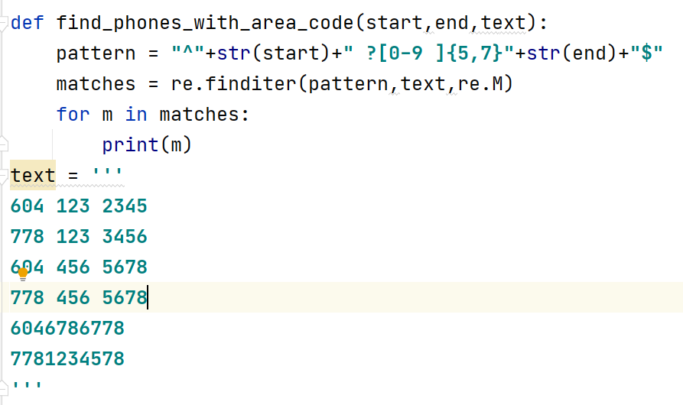
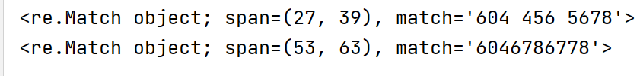
Longer re Examples
Lets find the phone numbers with a specific area code and ends with specific two digits
Function call:
Output:

Slide 31
Longer re Examples
A phone number can be either:
- ten digits in a row e.g. 6045551212
- three digits, space, three digits, space, four digits e.g. 604 555 1212
- three digits, hyphen, three digits, hyphen, four digits e.g. 604-555-1212
- three digits surrounded by (parentheses), space or not, three digits, space, four digits e.g. (604)555 1212
e.g. (604) 555 1212
if re.search("^\d{10}$|^\d{3} ?\d{3} ?\d{4}$|^\d{3}-?\d{3}-?\d{4}$|^\(\d{3}\) ?\d{3} ?\d{4}$", string): print("%s is a valid phone number" % string)

Slide 32
Number Ranges in Regular Expressions
To match an integer within a given range examine the range as a sequence of characters
Example:
To check if a number is between 1-12 (month numbers for example), the pattern of the numbers is as follows:
1-9 → if it is one digit number then it would be between 1-9
The pattern to match this case would be “[0-9]”
10-12 → if it is two digits number then the first digit is 1 and the second digit is between 0-2
The pattern to match this case would be “1[0-2]”
The result of combining those cases we get ➔ ”^([0-9]|1[0-2])$”

Slide 33
Number Ranges in Regular Expressions
To create a regular expression to look for a number in the range 52-126
break down the range pattern and create a regular expression for each pattern:
60 – 69 ➔ “6[0-9]”
70 – 79 ➔ “7[0-9]”
80 – 89 ➔ “8[0-9]”
90 – 99 ➔ “9[0-9]”
100 – 109 ➔”10[0-9]”
110 – 119➔”11[0-9]”
120 – 126➔”12[0-6]”
52 – 59 ➔ “5[2-9]”
➔ “5[2-9]”
Combine the regular expression patterns in a group
“^(5[2-9]|[6-9][0-9]|1[0-1][0-9]|12[0-6])$”
➔ “[6-9][0-9]”
NOTE:
Do not do this!
Instead, use the comparison operators such as greater than, less than, equals, and not equals, etc…. >= <
➔ “1[0-1][0-9]”
➔ “12[0-6]”

Slide 34
split()
The split() method is a commonly-used method; it takes a regular expression to split a string by delimiters.
import re
string1 = "this is beautiful british columbia, welcome“ string2 = "tiger,woods,golfer,1975,male“ string3 = "oprah,winfrey,tv,1954,female“ string4 = "wayne, gretzky,hockey player,1960,male"
list1 = re.split(" ", string1) list1b = re.split("is", string1) list2 = re.split(",|o", string2) list3 = re.split(",", string3) list4 = re.split("[aeiou]", string4)
print(list1) print(list1b) print(list2) print(list3) print(list4)
['this', 'is', 'beautiful', 'british', 'columbia,', 'welcome']
['th', ' ', ' beautiful brit', 'h columbia, welcome']
['tiger', 'w', '', 'ds', 'g', 'lfer', '1975', 'male']
['oprah', 'winfrey', 'tv', '1954', 'female']
['w', 'yn', ', gr', 'tzky,h', 'ck', 'y pl', 'y', 'r,1960,m', 'l', '']

Slide 35
split()
import re
string1 = "tiger,woods,golfer,1975,male"
list1 = re.split("[,o]", string1) # regex
print(list1)

Slide 36
When to avoid regex
Don’t use regex simply to validate substrings; use if substring in string instead
Don’t use regex to validate number ranges; use <= and >= instead
Don’t use regex simply to validate lengths of strings; use <= len() and >= len() instead
Don’t recreate the wheel; e.g. https://emailregex.com
import re
string = "150"
if re.search(r"^[132-438]$", string): # this means any single character 1,3,2,3,4,3,or 8
print("match")
else:
print("no")

Slide 37
Variables in raw formatted strings
import re string = "8V7N4P5" l = "[a-zA-Z]" d = "[0-9]" if re.search(rf"^{l}{d}{l} ?{d}{l}{d}$", string): print("match") else: print("no")

